Slide 1

Bioinformatics

Slide 2
About Protein
Proteins are complex, high molecular mass organic compounds that consist of amino acids joined with the help of peptide bonds.
Proteins play a vital role in the structure and functioning of all living cells as well as viruses. Different types of proteins perform various kinds of functions. These include the function as enzymes where proteins catalyze or accelerate the chemical reaction without self-consumption.
In biochemistry, this shorter and more general term is frequently used to refer to alpha amino acids, which are those amino acids in which the amino and carboxylate functionalities are attached to the same carbon, also called the a-carbon.
A peptide bond is a chemical bond formed between two molecules when the carboxyl group of one molecule reacts with the amino group of the other molecule, releasing a molecule of water.

Slide 3
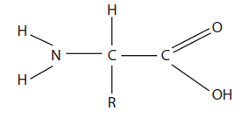
Protein Structure
These are polymers built from 20 different L-alpha-amino acids (also known as residues) that fold into unique three-dimensional protein structures.
The shape into which a protein naturally folds is known as its native state, which is determined by its sequence of amino acids. The three-dimensional shape that they assume helps them to perform all their biological functions.
The general structure of an amino acid molecule.

Slide 4
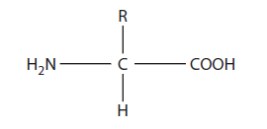
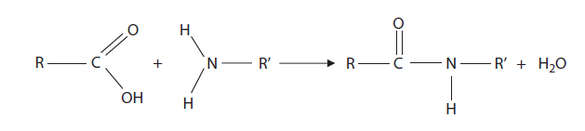
Protein Structure
The general structure of an a-amino acid.
The formation of the peptide bond.

Slide 5
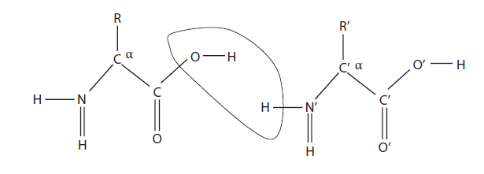
Four Distinct Aspects of a Protein’s Structure
The linking of amino acids.
Proteins are generally studied in four distinct aspects or structures. These are primary structure, secondary structure, tertiary structure, and quaternary structure.
The primary structure is the sequence of residues in the polypeptide chain. The secondary structure is a local, regularly occurring structure in proteins and is mainly formed through hydrogen bonds between backbone atoms.

Slide 6
Four Distinct Aspects of a Protein’s Structure
Tertiary structure describes the packing of alpha helices, beta sheets, and random coils with respect to each other on the level of one whole polypeptide chain. Quaternary structure only exists if there is more than one polypeptide chain present in a complex protein.
Protein Folding
The process by which the higher structures form is called protein folding and is a consequence of the primary structure.

Slide 7
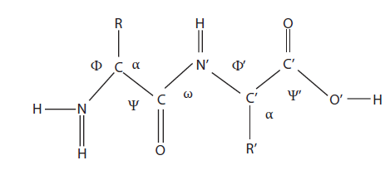
Protein Secondary Structure Theory
The two most common secondary structure arrangements are the right-handed alpha helix and the beta sheet that can be connected into a larger tertiary structure (or fold) by turns and loops of a variety of types.
These two secondary structure elements satisfy a strong hydrogen bond network within the geometric constraints of the bond angles w, y, and j.
The various bond angles in proteins.

Slide 8
Characteristics of Alpha Helices
A common motif in the secondary structure of proteins is the alpha helix (a helix).
This is a righthanded coiled conformation, resembling a spring, in which every backbone N-H group donates a hydrogen bond to the backbone C=O group of the amino acid four residues earlier (i + 4 → i hydrogen bonding).
An alpha helix has a partial positive charge at the amino end and a partial negative charge at the carboxyl end.
This in turn causes both ends of alpha helices to be polar, and therefore they are always at the surface of protein molecules.
The lengths of alpha helices vary from 4 or 5 residues to over 40 residues.

Slide 9
Characteristcs of Beta Sheets
Beta sheet is built from a combination of several polypeptide chains called beta strands.
Beta strands are usually 5 to 10 residues long. They are aligned to each other such that hydrogen bonds can form between CO groups of one beta strand and NH groups on an adjacent beta strand and vice versa.
The b sheet (also b-pleated sheet or b strand) is a commonly occurring form of regular secondary structure in proteins.

Slide 10
Characteristics of Loops
Loop regions occur at the surface of the protein molecule.
The main chain CO and NH groups of the loop regions, which generally do not form hydrogen bonds with each other, are exposed to the solvent and can form hydrogen bonds with water molecules.
Loop regions exposed to solvent have large quantities of charged and polar hydrophilic residues.
Each amino acid belongs to one of the eight following folding categories: H(a helix), G(310 helix), I(p helix), E(b strand), B(isolated b-bridge), T(turn), S(bend), and -(rest).

Slide 11
Problem Of Protein Structure determination
The protein folding problem—i.e., how to predict a protein’s three-dimensional structure from its one-dimensional amino-acid sequence—is often described as the most significant problem remaining in structural molecular biology.
There are two main computational alternatives to experimental methods of determining or predicting protein structure from sequence data.
The first approach is based on ab initio methods, which involve reasoning from basic physical principles. Ab initio methods rely on molecular physics and ignore any relationship of the molecule with other proteins.
The second approach, often termed heuristic methods, is based on some form of pattern matching, using knowledge of existing protein structures.

Slide 12
Application of Artificial Neural Networks
Artificial neural networks appear well suited for the empirical approach to protein structure prediction.
Similar to the process of protein folding, which is effectively finding the most stable structure given all the competing interactions within a polymer of amino acids, neural networks explore input information in parallel.
The aim of secondary structure prediction (SSP) is to estimate the kind of conformation that the backbone of a residue adopts for a particular sequence.
We consider the mainly helical (i.e., I spart of an a helix) and extended (like a strand of a b sheet) elements

Slide 13
Application of Artificial Neural Networks
Protein sequence: ABABABABCCQQFFFAAAQQAQQA
Conformation class: HHHH EEEE HHHHHHHH
Here H means Helical, E means Extended, and blanks are the remaining coiled elements.
We know from chemistry that the kind of secondary structure formed depends on how the residue and its neighbors in the sequence are interacting.
This is even true for b sheets; although there are rarely hydrogen bond interactions between the backbones or side chains in the same strand of a sheet, there are plenty between them.
For the two types of secondary structure, it is also necessary for the side chains of residues to pack together correctly.

Slide 14
Application of Artificial Neural Networks
In the context of prediction, the pattern is given in the “window” of neighboring amino acids around a residue:
Protein sequence: ABABABABCCQQFFFAAAQQAQQA
Conformation class: HHHH EEEE HHHHHHHH
The problem of prediction, when viewed this way, should be solved by using a form of one-dimensional (1D) pattern classification.
It is not straightforward, because there are many possible patterns, and the secondary structure may not always depend on just the local residue pattern; there is chance of exceptions.
We use a classification method for secondary structure prediction in form of neural networks. They can learn which patterns of residues correspond to a particular type of secondary structure, based on the measurements from protein structure.

Slide 15
Application of Artificial Neural Networks
For protein secondary structure prediction, we use a feed-forward neural network. Feed-forward nets are the most well known and widely used class of neural network.
In common with all neural networks, feed-forward networks are trained, rather than programmed, to carry out the chosen information processing tasks.
In this model, a window of residues is applied at the input side and the corresponding secondary structure (a helix, b sheet, or coil) of central residues is applied at target side for training. Also, nodes are connected in a feed-forward manner.
The back propagation training algorithm is used as the training algorithm

Slide 16
System Analysis
System analysis, which is a management technique for designing a new system or improving an existing system, is implemented in order to analyze the system in an orderly grouping of interdependent components linked together according to a plan to achieve a specific goal.
As our system protein secondary structure prediction is the task of a neural network, we apply system analysis for the following tasks:
1. Deciding the size of the input vector and the size of the output vector
2. Deciding which topology of neural network is suitable
3. Deciding which learning law is more suitable for our problem.
The structure of a protein reveals important information, such as the location of probable functional or interaction sites, identification of distantly related proteins, discovery of important regions of the protein sequence that are involved in maintaining the structure.

Slide 17
The Approach
Outlined next is the typical methodology used to train a feed-forward network for secondary structure prediction.
Each training pair is of the form
Pattern: LSADQISTVQASF
Target: H
i.e., each pattern is a window onto a short segment of protein chain centered on the residue to be predicted (in this instance, the central Ser residue, which forms part of a helix).
Class of secondary structure: Each amino acid belongs to one of the eight following folding categories: H(a helix), G(310 helix), I(π helix), E(b strand), B(isolated b bridge), T(turn), S(bend) and -(rest).

Slide 18
The Approach
This information has been used to train with supervised learning the three classifiers that we have described. Since the length of proteins, in terms of amino acids, varies, we have used a window of length n.
In this implementation, we take three cases for n = 13, 15, 17.
For instance, given the following subsequence of a protein (upper line), we wish to train a classifier to predict the secondary structure of the middle amino acid (lower line).
Amino acid sequence: ISFAPQSGYTSGA
Secondary structure: T

Slide 19
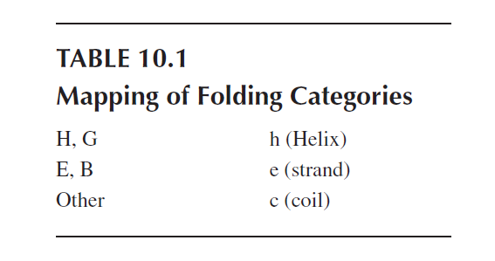
The Approach
As is customary in the literature, we have mapped the eight folding categories into three, following the DSSP standard. These are given in Table :
After using these eight folding categories in three classes, mapping that relation becomes
Amino acid sequence: ISFAPQSGYTSGA
Secondary structure: C

Slide 20
Encoding Scheme
We have to convert the letters for the amino acids and the secondary structure class into the values that are used in a neural network.
We had adopted the unary coding for each amino acid, which produces an input vector of 21 * n dimensions. There are 20 amino acids plus another symbol to denote the left or right end of the protein.
We use feed-forward neural network for the prediction of secondary structure from a window of input amino acid sequences.
Str = {A, C, D, E, F, G, H, I, K, L, M, N, P, Q, R, S, T, V, W, Y}

Slide 21
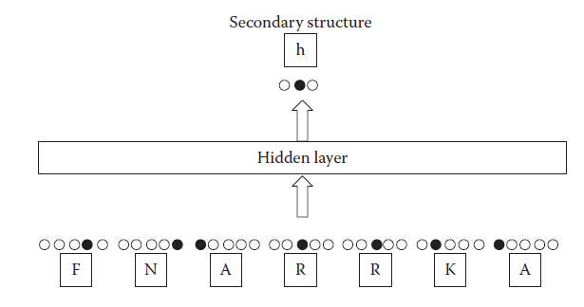
Encoding Scheme
The general working of the artificial neural network in the problem
Here each letter represents one of the 20 amino acids.

Slide 22
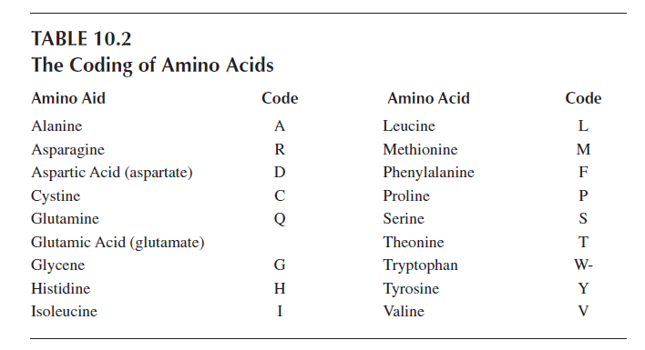
Encoding Scheme
By including a gap (say the left/right end of the protein), string Str becomes of size 21.
Str = {A, C, D, E, F, G, H, I, K, L, M, N, P, Q, R, S, T, V, W, Y, -}

Slide 23
Encoding Scheme
Here “-” is denoted by X (or x) in the implementation.
Hence the general representation of str is
Str = {A, C, D, E, F, G, H, I, K, L, M, N, P, Q, R, S, T, V, W, Y, X}
As mentioned earlier, we have applied unary coding for each amino acid. That means that each letter corresponds to the codes :
A = [1 0 0 0 0 0 0 0 0 0 0 0 0 0 0 0 0 0 0 0 0]
C = [0 1 0 0 0 0 0 0 0 0 0 0 0 0 0 0 0 0 0 0 0]
D = [0 0 1 0 0 0 0 0 0 0 0 0 0 0 0 0 0 0 0 0 0]
E = [0 0 0 1 0 0 0 0 0 0 0 0 0 0 0 0 0 0 0 0 0]

Slide 24
Encoding Scheme
W = [0 0 0 0 0 0 0 0 0 0 0 0 0 0 0 0 0 0 1 0 0]
Y = [0 0 0 0 0 0 0 0 0 0 0 0 0 0 0 0 0 0 0 1 0]
X = [0 0 0 0 0 0 0 0 0 0 0 0 0 0 0 0 0 0 0 0 1]
It may be seen that the size of input vector is 21n. Here n is the window size.
We now discuss for the output side or the secondary structure. The secondary structure can be modeled by other finite strings over the alphabet given by Equation :
S = {a, b, c}
For implementation, in my work we take S = {h, e, c}, where each letter indicates that the amino acid is part of an a helix or a b sheet, or else it is classified as c-coil. The encoding is given by :
h = [1 0 0]
c = [0 1 0]
e = [0 0 1]

Slide 25
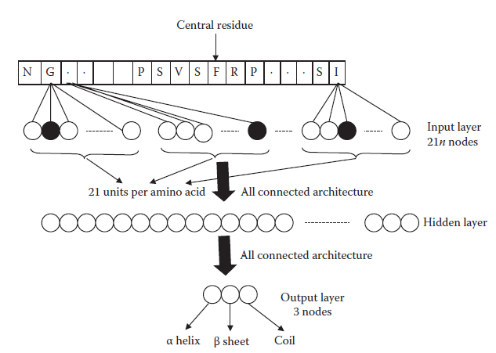
Architecture of the Artificial Neural Network
The architecture of the artificial neural network.

Slide 26
Procedure
we now come to the step-by-step working procedure for solving the problem of protein structure prediction. Here we start with the manner in which the data is collected and processed. We then discuss the training and the testing of the ANN with BPA.
Data Source and Description
We use data for training and testing collected from the “RCSB Protein Data Bank.” Each structure in the PDB is represented by a four-character identifier of the form [0-9][a-z, 0-9][a-z, 0-9] [a-z, 0-9].
The training and testing data are both in Matlab .mat file format: “traindata.mat” and “data_for_testing.mat.”
In the traindata.mat file, we have 44 variables, corresponding to 44 proteins. The variable names always start with an “X” following the 4 PDB code of that protein in lowercase letters. In the data_for_testing.mat file, we have 12 variables, corresponding to 12 proteins.

Slide 27
Procedure
The variables name always start with an “X” following the 4 PDB code of that protein in lowercase letters. The variables are formatted as a Matlab character array. Each variable has two rows; the length of the column will depend on the length of the residue of the protein.
The first row is the one-letter amino acid code. Letter code “X” means unknown amino acid. The second row is the observed secondary structure code corresponding to the amino acid in the first row of the same column:
H = helix
E = sheet
C = coils

Slide 28
Procedure
Example:
Protein (1DUR), with the corresponding variable name X1dur, has the following entries:
X1dur =
AYVINDSCIACGACKPECPVNCIQEGSIYAIDADSCIDCGSCASVCPVGAONOED
CEEECCCCCCCCCCHHHCCCCCEECCCCCEECCCCCCCCCHHHHHCCCCCEEECC
The array has the dimensions 2 × 55.
Starting from the first amino acid, with the corresponding index X1dur(1,1) = “A”, the corresponding observed secondary structure is in X1dur(2,1) = “C”. The second amino acid is in X1dur(1,2) = “Y”, and its observed secondary structure is in X1dur(2,2) = “E”.

Slide 29
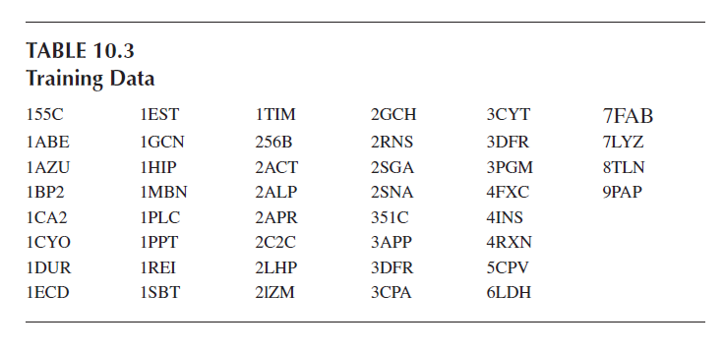
Procedure

Slide 30
Formation of Inputs and Outputs
Consider the X1dur sequence. The size of the sequence as discussed is 2 * 55. Let the window size n be 17. Here the window is a shrinking window.
Let p be the input and t be the output matrix. It may be seen that Size (p) = 17 * 41 and size (t) = 1 * 41.
To make p and t for each sequence with shrinking window size n, we follow the following steps:
Step 1: Initialization
X = seq; %assign any protein sequence variable
x = X(1,1:length(X));%assign primary sequence in x
t1 = X(2,1:length(X));%assign secondary in t1
x = [‘x’ x ‘x’ ] ; %appending gaps at end of sequence (x) ...denoted by x
p1 = []; p = []; c = 0;
Step 2: Repeat for i = 1 to (length(x) – (n – 1))

Slide 31
Formation of Inputs and Outputs
Step 3: Repeat for j = i to (n + c)
Step 4: x1 = (x(1,j)); %extracting jth position
p1 = [p1;x1]; %append columnwise
[End of Step 3 loop]
Step 5:
p = [p,p1]; p1 = []; c = c + 1;
[End of Step 2 loop]
Step 6: t = t1(1,(n – 1) / 2:length(t1) – ((n – 1) / 2 – 1)); %target
Step 7: Display and store matrix p and t
Step 8: Exit

Slide 32
Formation of Inputs and Outputs
This algorithm of making input p and target t is for a single protein sequence (with using the general window size n). For a batch input px and target tx matrix we use these steps in a sequence.
All the protein sequences are stored in a Matlab variable in the following manner:
Xdata2 = [ ];
Xdata2{1} = X155c;Xdata2{2} = X1abe;Xdata2{3} = X1cyo...Xdata2{44} = X6ldh
For generating input px and target tx with window size n, we use the following steps:
Step 1 Initialization
p = []; tx = []; px = []; k = 1; i = 1
Step 2 Repeat for k = 1 to length (Xdata2)

Slide 33
Formation of Inputs and Outputs
Step 3 X = Xdata2{k}
f = X(1,1:length(X)); %f = primary seq. of protein
s = X(2,1:length(X)); %s = secondary seq. of protein
f = [‘x’ f ‘x’]; %appending gap at end of seq. “gap = x”
p1 = []; p = []; c = 0;
Step 4 Repeat for i = 1 to (length( f) – (n – 1)
Step 5 Repeat for j = 1 to (n + c)
Step 6 x1 = ( f(1,j));
p1 = [p1; x1];
[End of Step 5 loop]
Step 7 p = [p, p1];
p1 = [];
c = c + 1;
[End of Step 4 loop]

Slide 34
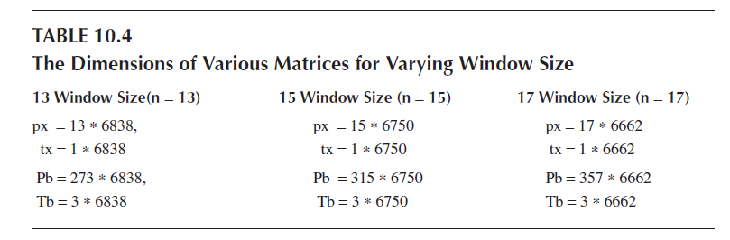
Formation of Inputs and Outputs
Step 8 p; px = [px, p]; px3 = px;
Step 9 tx = s(1,(n – 1) / 2:length(s) – ((n – 1) / 2) – 1));
Step 10 [End of step 1 loop]
Step 11 Exit

Slide 35
Formation of Inputs and Outputs
The final input matrix Pb is given by the following steps:
Step 1: load px and tx
Pb = []; %initialize
Step 2: Repeat for I = 1 to length (px)
Step 3: S = px (1:n, I)’;
Z = seq2bin (S);
Step 4: Pb = [Pb, Z’];
(End of Step 2 loop)
Step 5: Pb; save Pb
Step 6: Exit

Slide 36
Formation of Inputs and Outputs
The seq2bin function takes a string s as argument and gives output in binary using an encoding
scheme as mentioned earlier. For each character there is a 21-bit code.
The final target matrix Tb is given by the following steps:
Step 1: load tx
Step 2: Tb = sec2bin (tx)
Step 3: save Tb
Step 4: Exit

Slide 37
Training
We had selected a feed-forward network architecture. The network had an input layer, an output layer, and one hidden layer. Prior to training, the network weights and biases are initialized to small random values.
The training process requires a set of examples of proper network behavior. These are the inputs and target outputs as derived in the preceding section. During training, the weights and biases of the network are iteratively adjusted to maximize the network performance or minimize the error.
The back propagation algorithm (BPA) is used for training purposes. This algorithm uses the gradient of the performance function to determine how to adjust the weights to minimize performance.

Slide 38
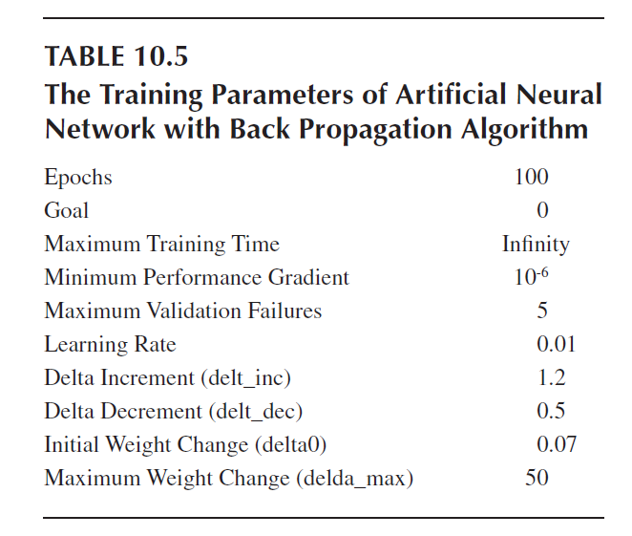
Training

Slide 39
Testing
The closeness of the outputs given by the system with the standard target output determines the system performance.
Consider the input X1fca. Here the primary sequence is as follows:
Primary Sequence =
AYVINEACISCGACEPECPVDAISQGGSRYVIDADTCIDCGACAGVCPVDAPVQA
By using the trained network, we get the result as follows:
CISCGACEPECPVDAISSQGGSRYVIDADTCIDCGACAGVCP
CCCCCCCHHHCCCCCEECCCCCCEECCCCCCCCCCHHHHCCC
CCCCCCCHHHCC-C----CCCCCEECCCCCCCCCCHHHH-CC
Here the first row is the primary sequence, the second row is the standard secondary structure.

Slide 40
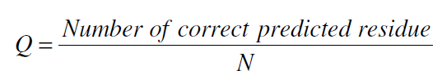
Results
The system discussed was tested for numerous inputs to determine the net performance of the system. This is done by applying numerous unknown inputs and asking the system to predict the correct outputs.
The quality (Q) is a measure of the closeness of the predicted sequence with the original sequence. This may be calculated by using Equation :

Slide 41
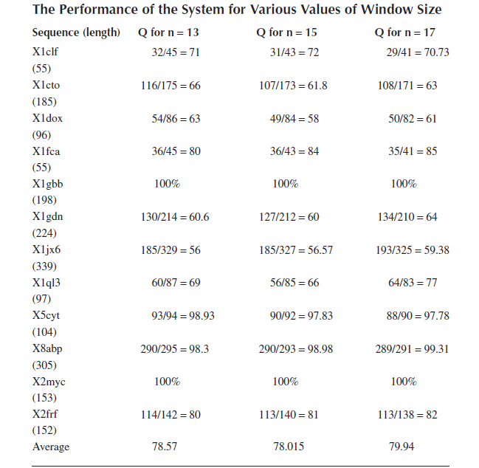
Results

